Slide 1
Data Analytics
Descriptive analytics
Diagnostic analytics
Predictive analytics
Prescriptive analytics

Slide 2
What tools do we use for data analytics
Jupyter and the python coding language with many data and machine learning libraries
Excel or google sheets or your favorite open source variant
Word or pdf or google docs or your favorite open source word processor
- Today You will be using jupyter, python and decision tree machine learning!

Slide 3
What tools do we use for data analytics
DO NOTEBOOKS.
Links in discord
Pair new programmers with comfortable coders

Slide 4
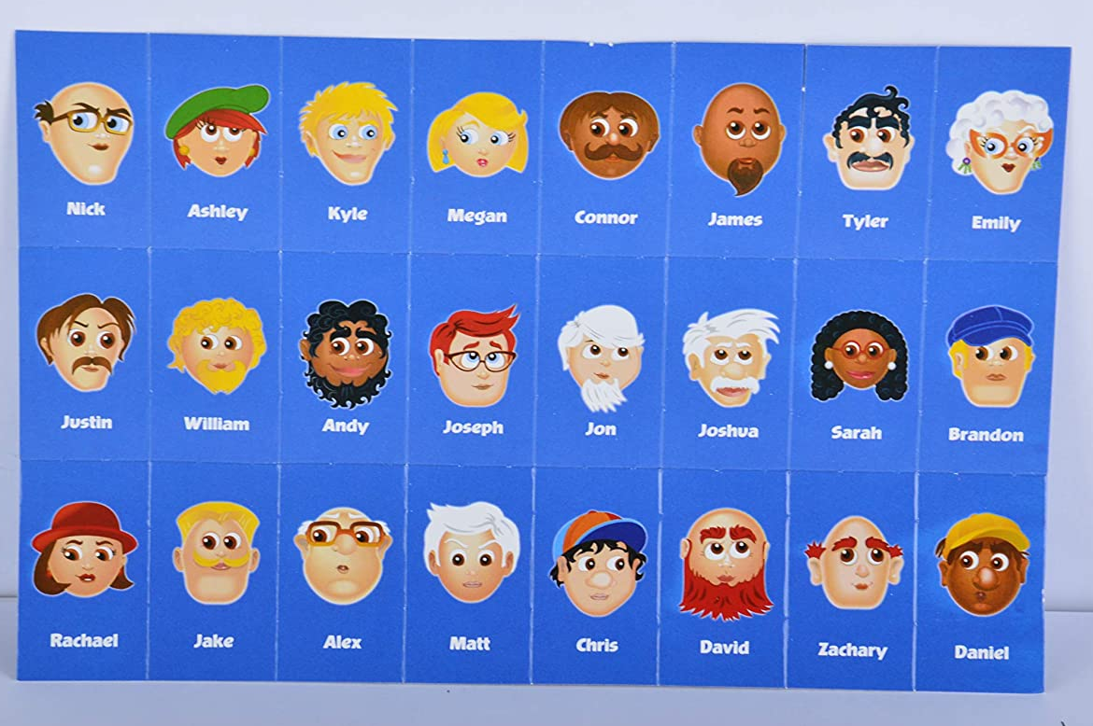
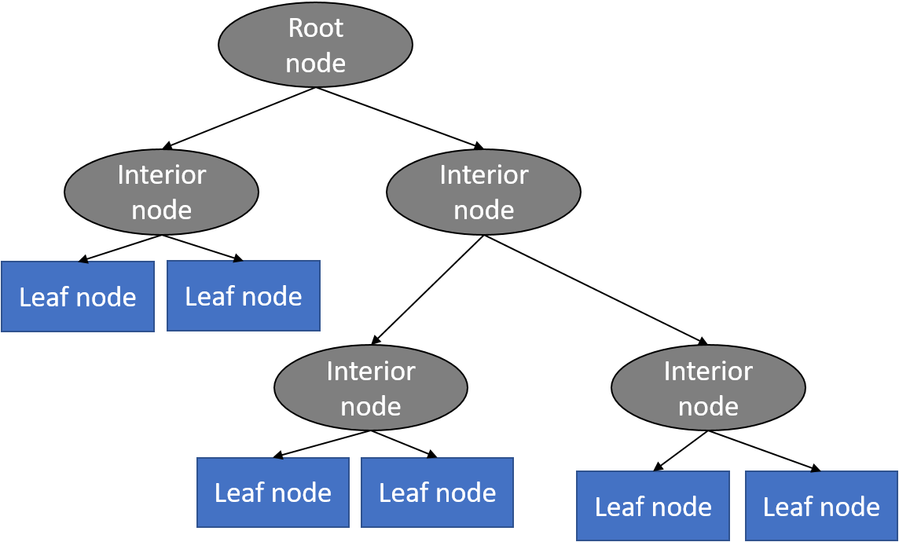

Slide 5
Soil Type
├── Clay Soil
│ ├── pH < 6.0 → Blueberries
│ ├── pH 6.0–7.0 → Wheat
│ └── pH > 7.0 → Alfalfa
├── Sandy Soil
│ ├── Low Water Retention → Cactus/Carrots
│ ├── Moderate Water Retention → Potatoes
│ └── High Water Retention → Tomatoes
└── Loamy Soil
├── Tropical Climate → Bananas
├── Temperate Climate → Corn
└── Arid Climate → Olives

Slide 6
Termanology
Root Node is the starting point that represents the entire dataset.
Branches: These are the lines that connect nodes. It shows the flow from one decision to another.
Internal Nodes are Points where decisions are made based on the input features.
Leaf Nodes: These are the terminal nodes at the end of branches that represent final outcomes or predictions

Slide 7
Decision tree

Slide 8
How does the model make choices?
Splitting Criterion
The goal at each branch is to find the feature and threshhold that maxamize the purity of the resulting subsets.
Gini impurity measures the likelihood of an incorrect classification of a random if a random label is chosen based on distribution of the data set. Calculated using the G(t) = 1 - ∑(p_i^2), where p_i is the proportion of data points in node t belonging to class i.
There is also entropy and information gain that can be used as splitting criterion.
Entropy=Entropy=−∑i=1∑c,i=1​ pi ​⋅log2​(pi​)
IG(T,a)=H(T)−H(T∣a) Information Gain is the difference between the entropy of the parent node and the weighted average entropy of the child nodes.
runtime is NlogN

Slide 9
Advantages of Decision Trees
Easy to understand and interpret
Handles numerical and categorical data
Minimal data processing required

Slide 10
Limitations of Decision trees
Prone to overfitting, especially with complex trees.
Sensitive to small changes in the data.
May create biased trees if some classes dominate.

